Slide 1
IBM HACK CHALLENGE 2020

Slide 2
Problem statement:-
Intelligent Post-Lock Down Management System for Public Transportation
Post-Lockdown, it will be risky to allow the public transportation without proper mechanism to maintain social distancing, especially the frequency of buses, trains and metros shall be managed properly to utilize the capacity with social distancing criteria.

Slide 3
Expected Solution:-
An intelligent app to schedule the timings of transportation , avoiding the over occupancy of public transport.
IBM Watson Assistant, Python 2 or 3, IBM Watson Studio, IBM Cloud for Deployment, Any Web/Mobile app frameworks.
1. https://www.transformative-mobility.org/news/the-covid-19-outbreak-and-implication-to-public-transport-some-observation
2. https://www.teriin.org/article/effects-covid-19-transporatation-demand
3. https://www.uitp.org/public-transport-and-covid-19
Technologies and Tools:-
Reference

Slide 4
TEAM : ENIGMA Our team ENIGMA consists of 4 members: 1. Aditi Akhilesh Electronics and Communication Engineering Student Saintgits College of Engineering, Kottayam 2. Anakha P Kumar Electronics and Communication Engineering Student Saintgits College of Engineering, Kottayam 3. Christy Zachariah Electronics and Communication Engineering Student Saintgits College of Engineering, Kottayam 4. Femi Elsa Thomas Electronics and Communication Engineering Student Saintgits College of Engineering, Kottayam

Slide 5
Role of Team members:- Each of the team member was assigned specific tasks . We created the project template . The project contained six milestones. Each milestone had activities inside it. Each activity is the duty of one of the team members. Creating the report was another task. That was done together. In short, the entire task was the combined effort of all the team members.

Slide 6
Technologies/Platform used:-
Watson Studio
Cloud Foundry
Node RED
Cloudant
Continuous Delivery

Slide 7
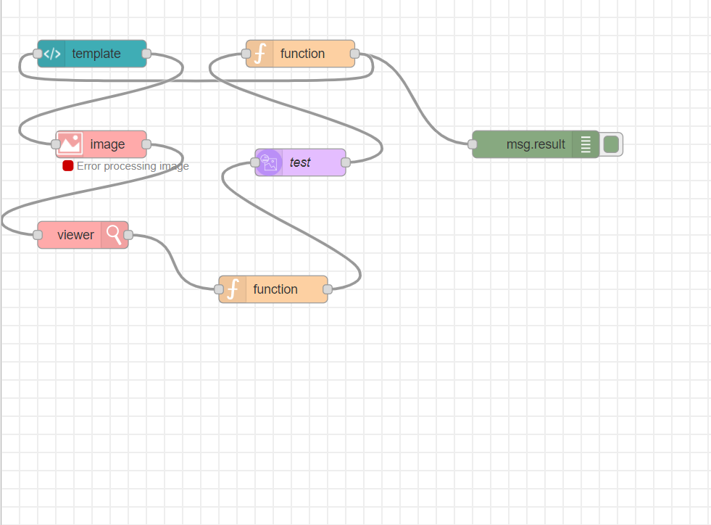
Flow Diagram:-

Slide 8
Node-RED
Node-RED was used for creating the UI. It is a flow based development tool for visual programming developed originally by IBM. Node-RED provides a web browser-based flow editor. The runtime is built on Node.js
It is a visual tool for wiring the Internet of Things.

